Slide 1
Design And Analysis of Algorithms ESTABLISHING ELECTRIC GRID IN A TOWN USING BORUVKA’S ALGORITH
By
V. Abhiram (2010030180)
R. Vivek Vardhan Reddy (2010030142)
K. Sidharth Rao(2010030443)
Raghavendra Goud(2010030394)
Under the guidance of
(Dr. P. Sree Lakshmi)

Slide 2
ABSTRACT
Minimum spanning tree can be obtained for connected weighted edges with no negative weight using classical algorithms such as Boruvka's, Prim's and Kruskal. This paper presents a survey on the classical and the more recent algorithms with different techniques. This survey paper also contains comparisons of MST algorithm and their advantages and disadvantages.

Slide 3
Problem statement and domain
Lets take a situation where we have a city which has so many towns in it, and the distances between pairs of the town are known. The goal is to create a system of electric power lines that would minimize the total distance (and thus the construction cost), yet reach every town. In this scenario, it is not necessary to connect each town to the “source of electricity” directly – it is enough to connect it to another town that already got the power.
The problem which we chose comes under the domain of GREEDY METHOD. Greedy is an algorithmic paradigm that builds up a solution piece by piece, always choosing the next piece that offers the most obvious and immediate benefit. So the problems where choosing locally optimal also leads to global solution are best fit for Greedy.
In this scenario, we have to find the MINIMUM COST SPANNING TREE. The cost of the spanning tree is the sum of the weights of all the edges in the tree. There can be many spanning trees. Minimum spanning tree is the spanning tree where the cost is minimum among all the spanning trees.

Slide 4
Existing solutions/ Naïve solutions
PRIM’S ALGORITHM:-
Prim's Algorithm is a greedy algorithm that is used to find the minimum spanning tree from a graph. Prim's algorithm finds the subset of edges that includes every vertex of the graph such that the sum of the weights of the edges can be minimized.
KRUSKAL’S ALGORITHM:-
Kruskal's Algorithm is used to find the minimum spanning tree for a connected weighted graph. The main target of the algorithm is to find the subset of edges by using which we can traverse every vertex of the graph. It follows the greedy approach that finds an optimum solution at every stage instead of focusing on a global optimum.

Slide 5
REVERSE DELETE ALGORITHM:-
In Reverse Delete Algorithm, we sort all edges in decreasing order of their weights. We then pick each edge from the sorted list and remove it from the graph, if removing it keeps the graph connected, we continue, else we add the edge again.

Slide 6
Proposed Algorithm Design Technique
BORUVKA’S ALGORITHM
Boruvka's algorithm is a greedy algorithm for finding a minimum spanning tree in a graph. The algorithm begins by finding the minimum-weight edge incident to each vertex of the graph, and adding all of those edges to the tree. Then, it repeats a similar process of finding the minimum-weight edge from each tree constructed so far to a different tree, and adding all of those edges to the forest. Each repetition of this process reduces the number of trees, within each connected component of the graph, to at most half of this former value, so after logarithmically many repetitions the process finishes.
This algorithm can be applied in our problem in the following way. For each town, connect it with its nearest neighboring town. Now, for each of the resulting groups of towns, connect them to their nearest neighbor... Proceed until there is just one group left.

Slide 7
Data Structures needed
The data structure used in the implementation of Boruvka’s algorithm is disjoint-set data structure, also called a union–find data structure.
For instance, we have a set of N elements which are partitioned into further subsets, and we have to keep track of connectivity of each element in a particular subset or connectivity of subsets with each other. To do this operation efficiently, we can use Union-Find Data Structure.

Slide 8
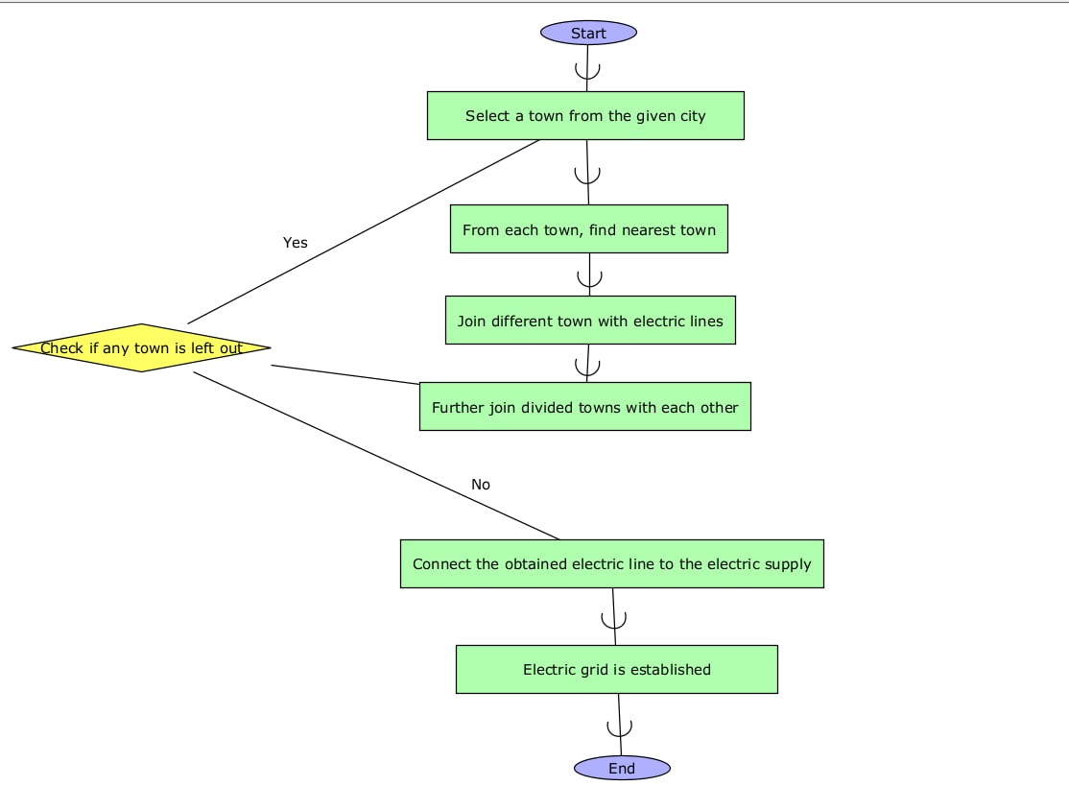
FLOWCHART

Slide 9
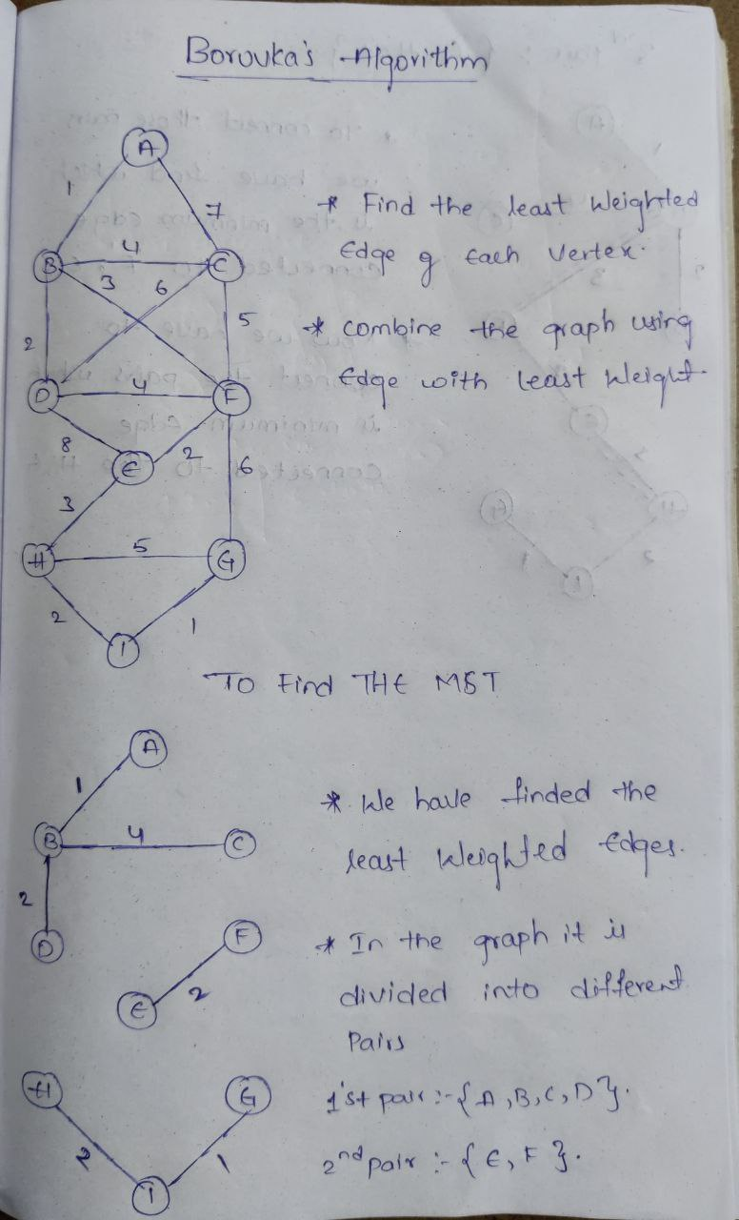
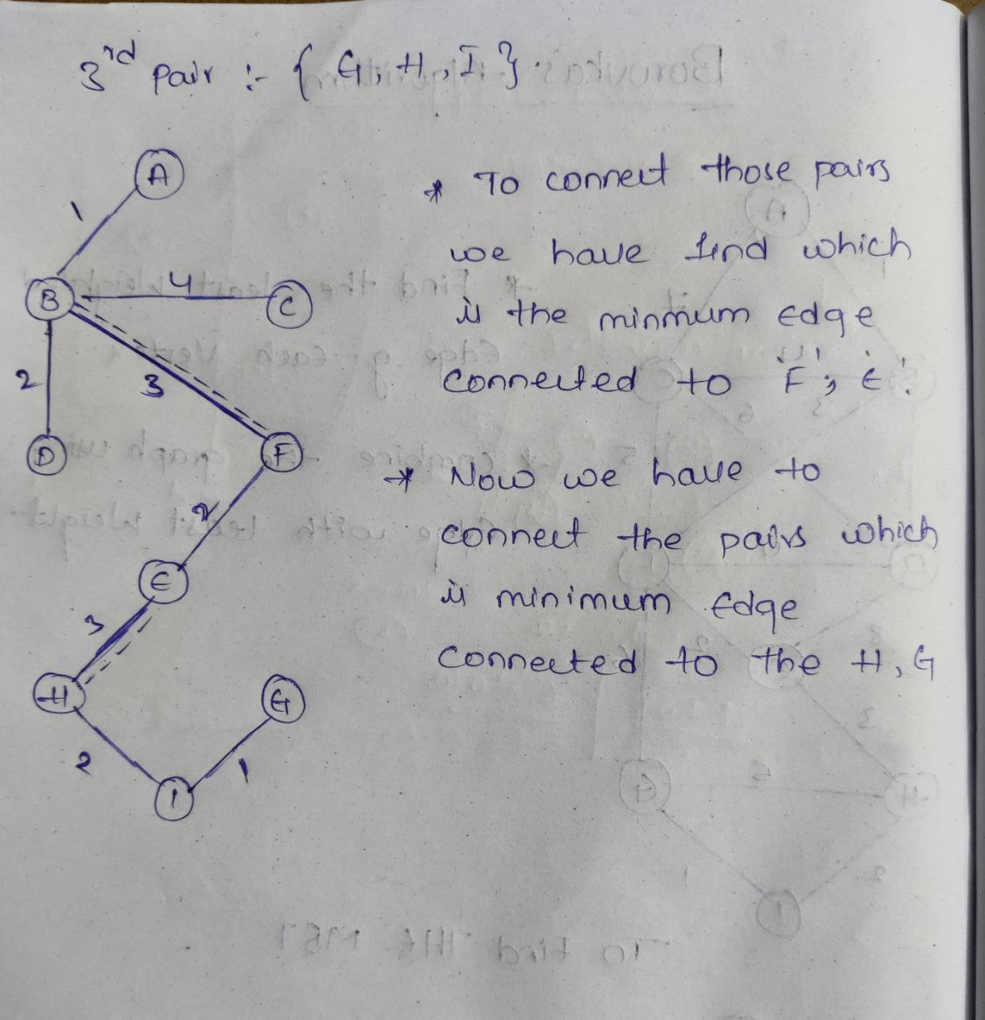
NUMERIC EXAMPLE OF THE ALGORITHM

Slide 10
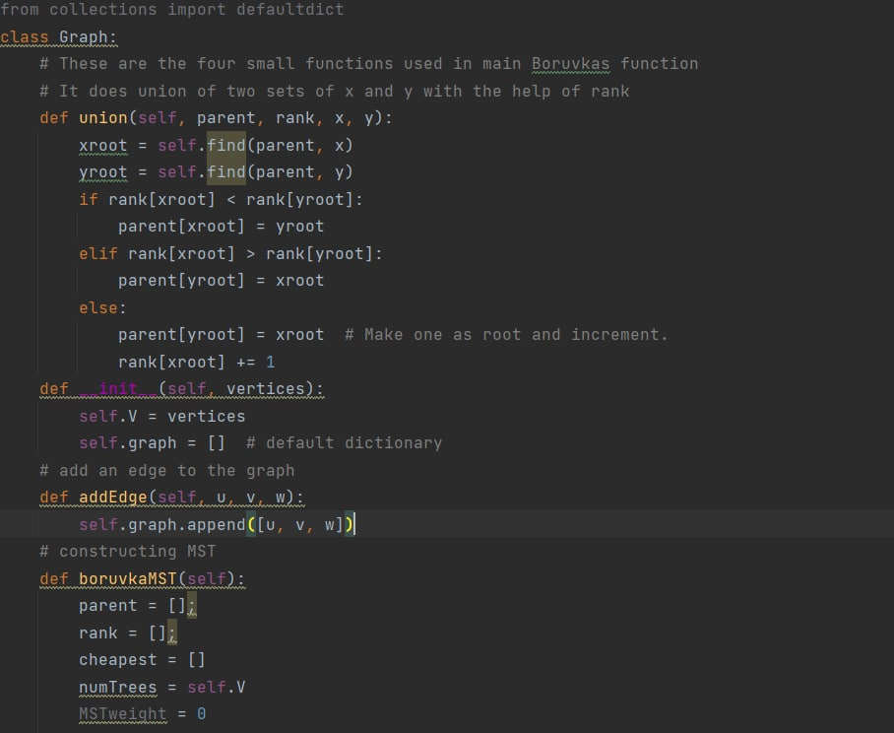
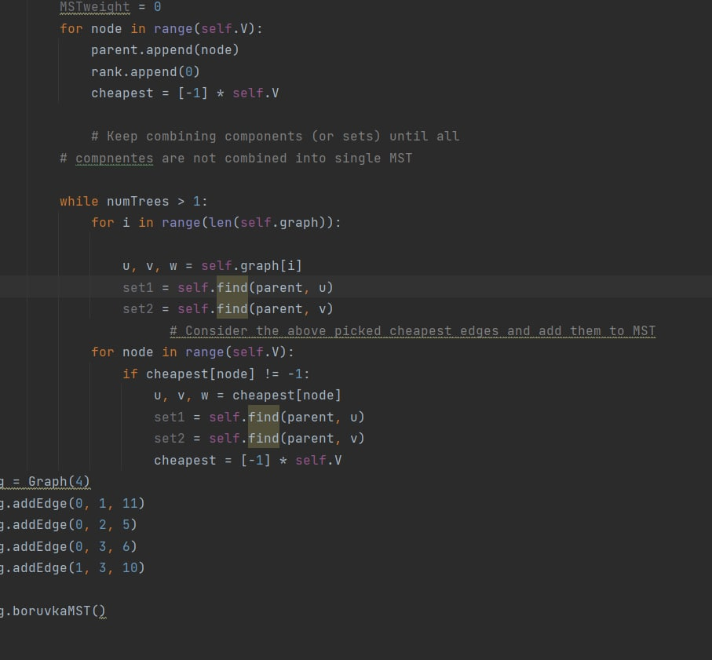
CODE AND IMPLEMENTATION

Slide 11
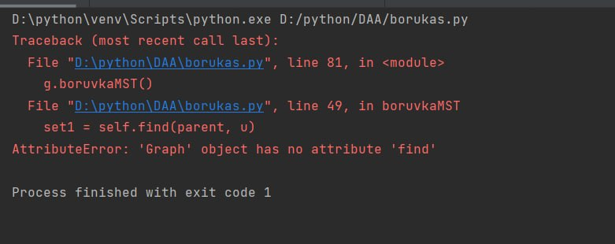
ALPHA TESTING

Slide 12
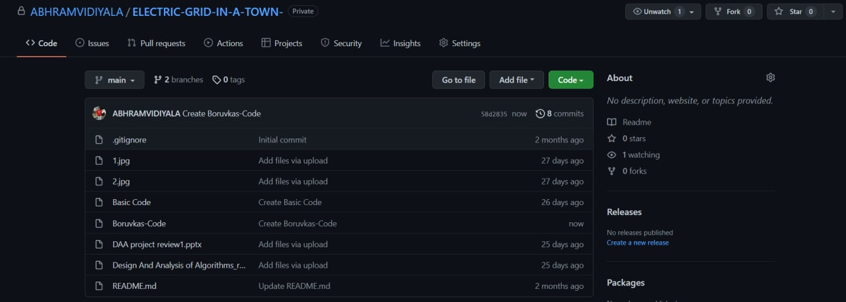
GITHUB COMMITS

Slide 13
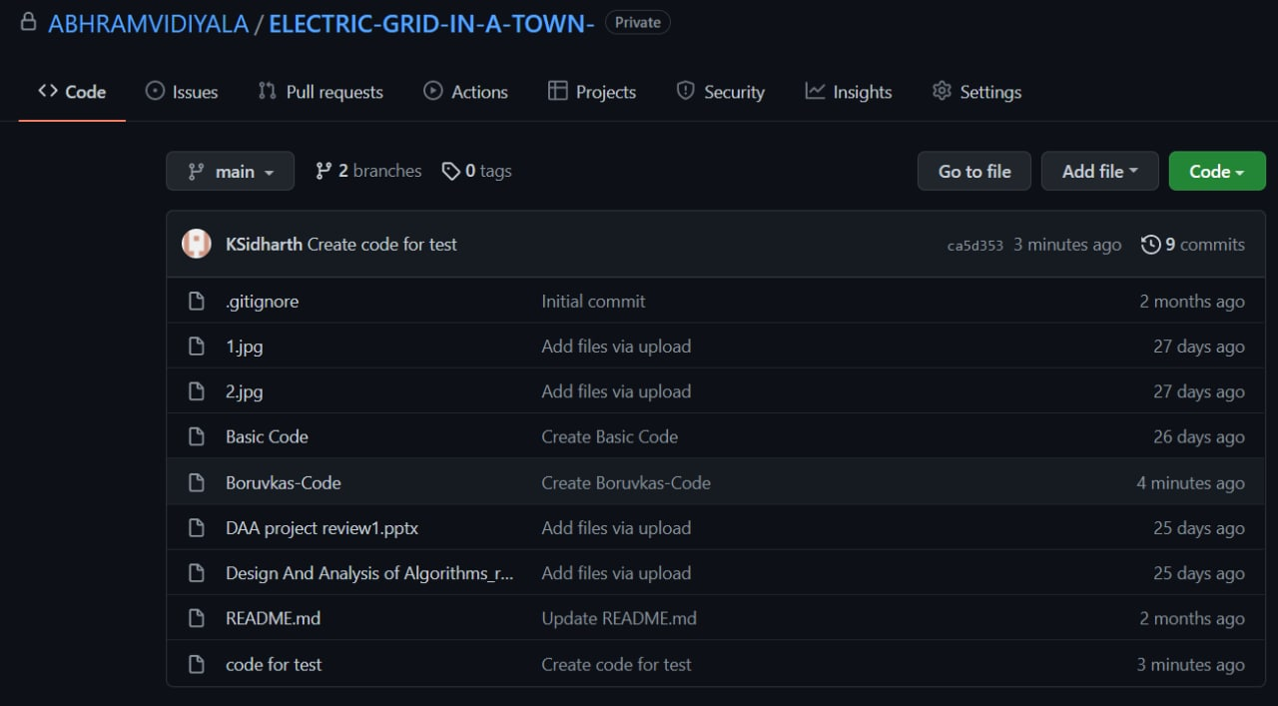

Slide 14
FUTURE SCOPE
In the future, we will explore and test our developed algorithm “BORUVKA’S” in various domains. It is an important combinatorial optimization problem which is improved in recent times. The availability of reliable software, extremely fast and inexpensive hardware and high –level languages that make the modeling of complex problems faster have led to much greater demand for optimization tools. Keeping the above points of view our future work will more emphasize much larger problems on personal computers, much of the necessary data is routinely collected and tools exist to speed up both the modeling and the post optimality analysis.The front end can be also added to this.

Slide 15
HARDWARE AND SOFTWARE REQUIREMENTS
HARDWARE:
Modern Operating System:
Windows 7 or 10
Mac OS X 10.11 or higher, 64-bit
Linux: RHEL 6/7, 64-bit (almost all libraries also work in Ubuntu)
x86 64-bit CPU (Intel / AMD architecture)
4 GB RAM
5 GB free disk space
SOFTWARE:
Python3
Pycharm community(IDE)

Slide 16
THANK YOU

